Slide 1
Overview: Errors, Exceptions, Threads & File Handling
Presented By: Mirazul Islam Java Instructor, EU

Slide 2
Types of Errors in Programming
Major types:
Syntax Error
Logical Error
System Error

Slide 3
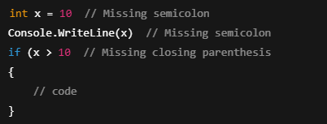
Syntax Error
Definition:
An error that occurs when code violates the rules of the programming language.
Detected:
At compile time (or before execution in interpreted languages).
Characteristics:
Program won’t compile or run.
Easy to detect and fix.

Slide 4
Logical Error
Definition:
Code runs without crashing but produces incorrect results due to flawed logic.
Detected:
At runtime, through unexpected behavior/output.
Characteristics:
Harder to identify.
No error message shown.

Slide 5
System Error (Fatal Error)
Definition:
Serious problems not handled by the program, often due to hardware or environment issues.
Characteristics:
Not recoverable.
Often causes program or system crash.
Examples:
StackOverflowError
OutOfMemoryError
System crash due to corrupted memory

Slide 6
What is an Exception?
Definition: Conditions that disrupt program flow but can be handled.
Examples:
File not found
Divide by zero
Invalid user input
Characteristics:
Often predictable.
Can be caught and handled gracefully.

Slide 7
Exception Handling Mechanism
try – code block where exception may occur.
catch – handles the exception.
finally – optional block that executes regardless of exception.
throw – used to explicitly raise an exception.

Slide 8
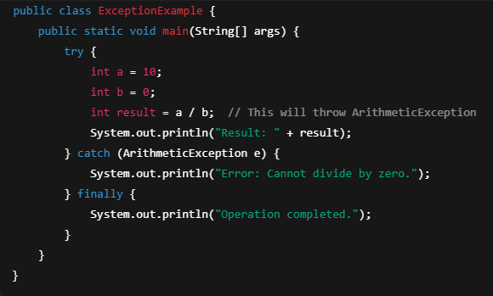
Example Code – Try-Catch in Java

Slide 9
What is a Thread?
A thread is a lightweight subprocess.
It is the smallest unit of execution.
Threads run concurrently within a program.
Java supports multithreading natively.

Slide 10
Benefits of Multithreading
Improved application performance.
Efficient use of CPU resources.
Better user experience with responsive UI.
Useful for performing multiple tasks simultaneously.

Slide 11
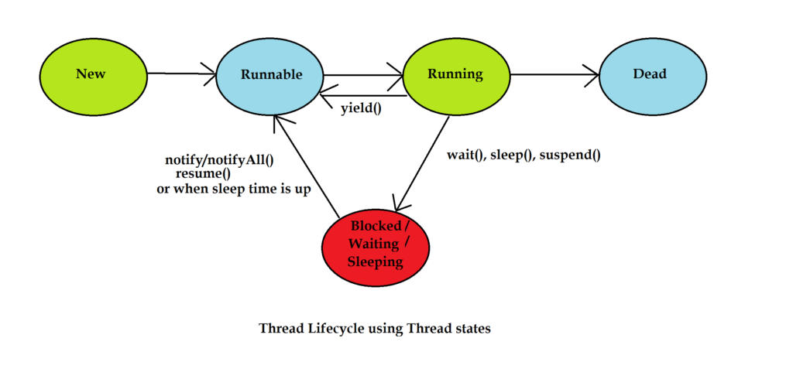
Java Thread Lifecycle
States:
New – Thread is created.
Runnable – Ready to run.
Running – Currently executing.
Blocked/Waiting – Waiting for resources.
Terminated – Execution finished.

Slide 12
Creating Threads in Java
Extending Thread class
class MyThread extends Thread {
public void run() {
System.out.println("Thread running");
}
}
Implementing Runnable interface
class MyRunnable implements Runnable {
public void run() {
System.out.println("Thread running");
}
}

Slide 13
Starting a Thread
MyThread t1 = new MyThread();
t1.start(); // Starts a new thread
// OR
Thread t2 = new Thread(new MyRunnable());
t2.start();

Slide 14
Thread Methods
start() – Starts the thread.
run() – Defines thread's code.
sleep(ms) – Pauses thread for milliseconds.
join() – Waits for thread to die.
isAlive() – Checks if thread is alive.

Slide 15
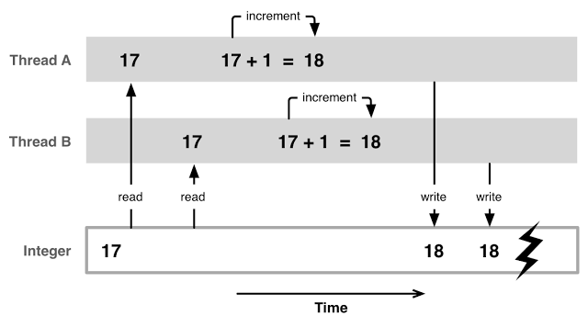
Synchronization
Prevents race conditions.
Ensures thread safety.
synchronized void myMethod() {
// thread-safe code
}

Slide 16
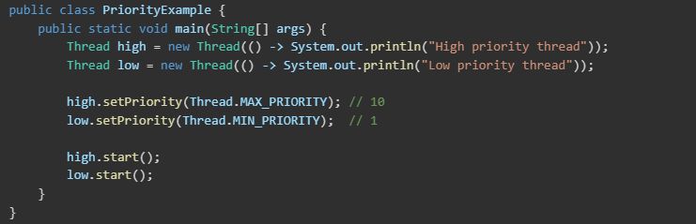
Thread Priorities
Values: MIN_PRIORITY, NORM_PRIORITY, MAX_PRIORITY
Constant | Value | Description
Thread.MIN_PRIORITY | 1 | Lowest priority
Thread.NORM_PRIORITY | 5 | Default priority for threads
Thread.MAX_PRIORITY | 10 | Highest priority

Slide 17
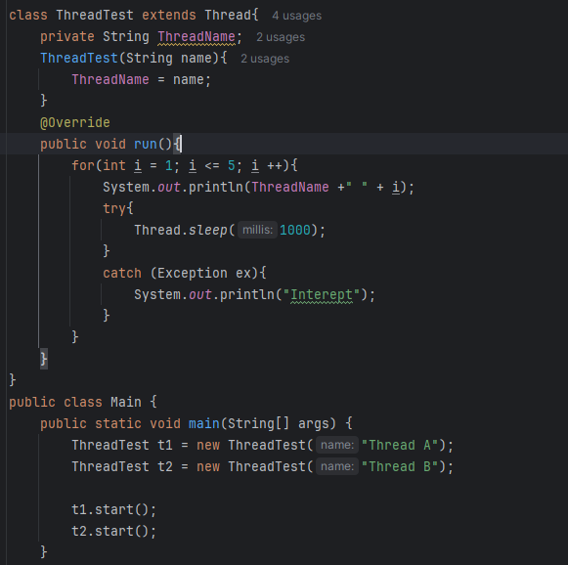

Slide 18
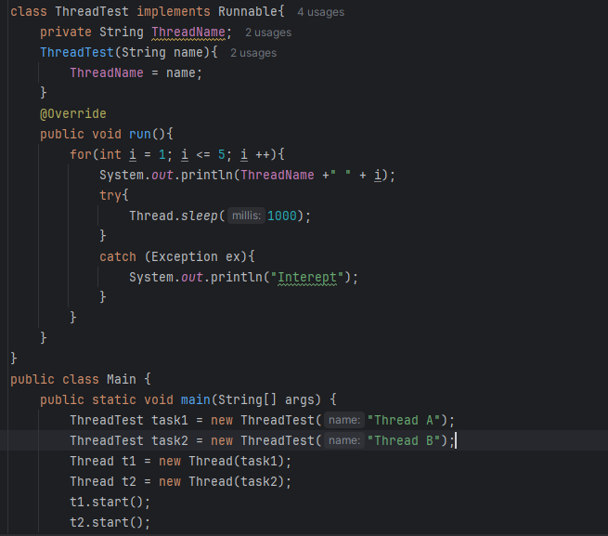

Slide 19
Real-Life Examples
Web servers handling multiple client requests.
Video games with separate threads for rendering, input, and audio.
Background data processing in mobile apps.

Slide 20
Introduction to File Handling
Java provides built-in classes for file handling.
Common file operations include reading, writing, and modifying files.
File handling in Java can be done using:
File class (for file properties and operations).
FileReader, FileWriter, BufferedReader, BufferedWriter.
NIO (New I/O) for advanced file handling.

Slide 21
What is a Stream?
A stream is a sequence of data that flows from a source to a destination.
Used in file handling for input and output operations.
Types of Streams:
Input Stream → Reads data (e.g., FileInputStream, BufferedReader)
Output Stream → Writes data (e.g., FileOutputStream, BufferedWriter)

Slide 22
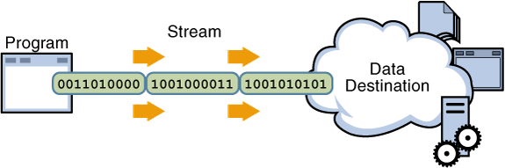
Streams
I/O Stream
Byte Stream
Character Stream
Input Stream
Classes
Output Stream Classes
Reader classes
Writer Classes

Slide 23
Java Methods Use in File Type
createNewFile() – Creates a new empty file.
exists() – Checks if the file exists.
delete() – Deletes a file.
renameTo(File dest) – Renames the file.
canRead(), canWrite() – Checks read/write permission.
length() – Returns the file size in bytes.
getName(), getPath() – Returns file name/path.
isFile(), isDirectory() – Checks file or directory type.

Slide 24
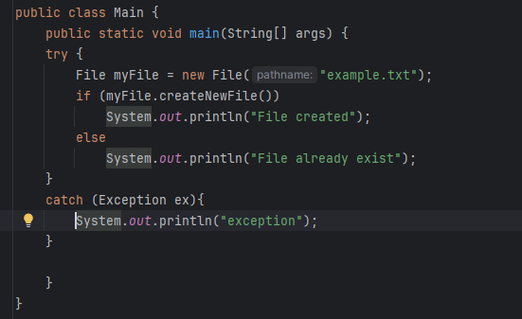
Create a File

Slide 25
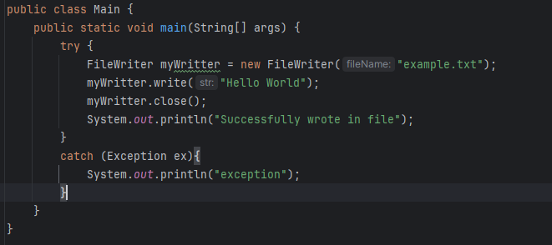
Java File Writer

Slide 26
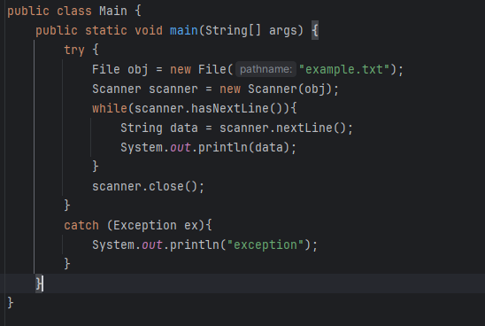
Java File Reader

